Slide 1


Digital Skill Fair 36.0 - Data Science
PORTFOLIO
Iris Dataset using Decision Tree Algorithm
by Kania Tri Hapsari

Slide 2

DESCRIPTION
The goal of this project is to create a machine learning program (classification) with decision tree algorithm using iris dataset from scikit learn.
As for the dataset, the iris flower dataset consists of three different types of iris flowers, namely setosa, versicolour, and virginica. Four features were measured from each sample, which are the length and width of the sepals and petals, in centimeters.

Slide 3






TOOLS & LIBRARIES

Slide 4
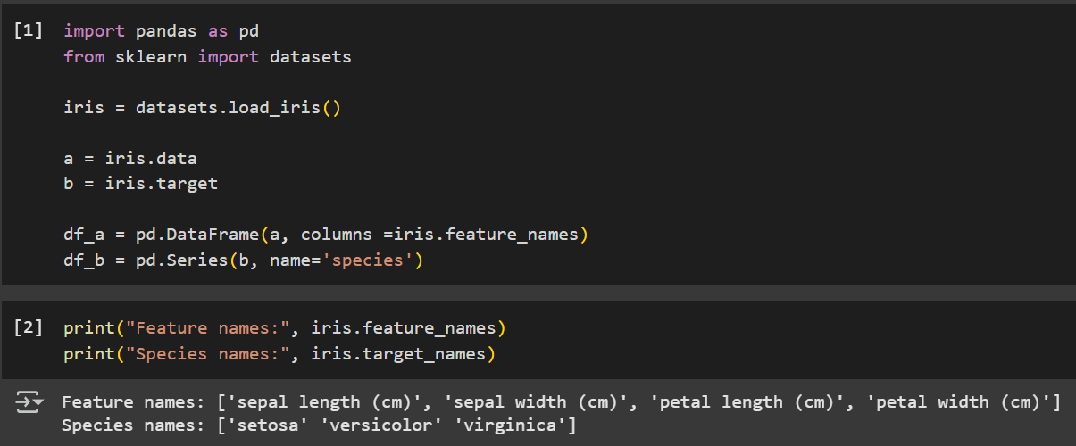
IMPORT LIBRARY &
READ DATASET

Slide 5
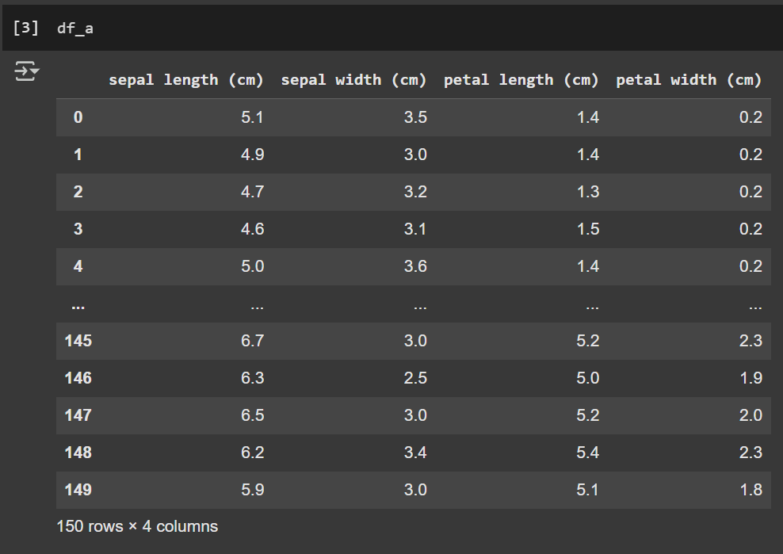
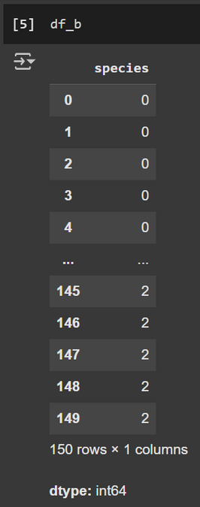


This is the dataframe of the target (or species). There is only one column.
0 means “setosa”
1 means “versicolor”
2 means “virginica”
This is the dataframe of the features. There are 150 data (rows) in each of the four feature types (columns).

Slide 6
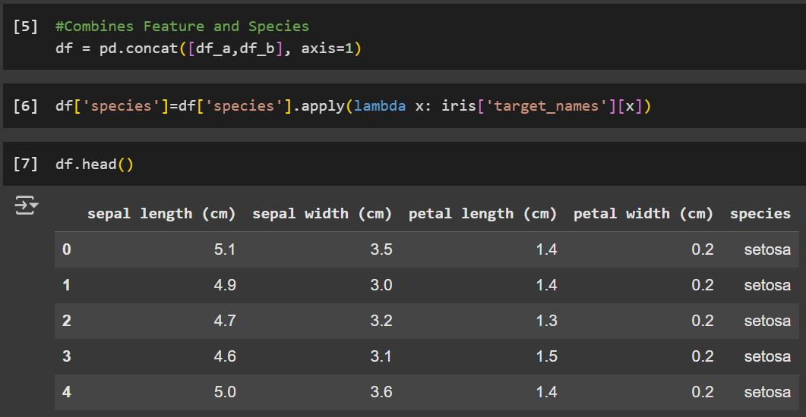
This concat() method is to combine the dataframe of features and species. The second one is to make the species dataframe come out with object types.
These are the top five dataframes after combining. You can see that for species, it doesn’t come out as integer, but object.

Slide 7
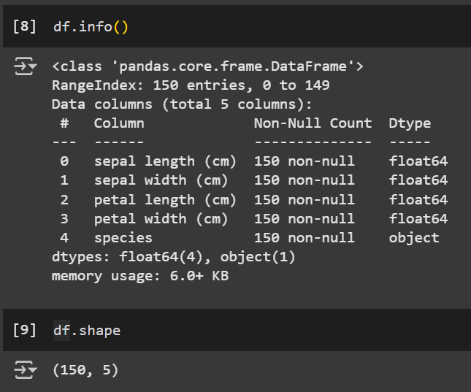
EXPLORATORY DATA ANALYSIS (EDA)
The .info() method prints information about the dataframe.
There is five columns in total.
The .shape method provides information about the number of rows and columns in the dataframe.
So, there is 150 rows and 5 columns for this dataframe.

Slide 8
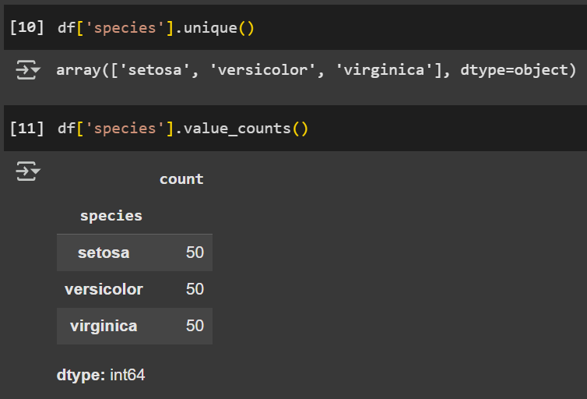
The .unique() method returns unique values from a data series.
The .value_counts() method counts the frequency of unique values in a series or dataframe column.
So, there are 50 in each of the three species.

Slide 9
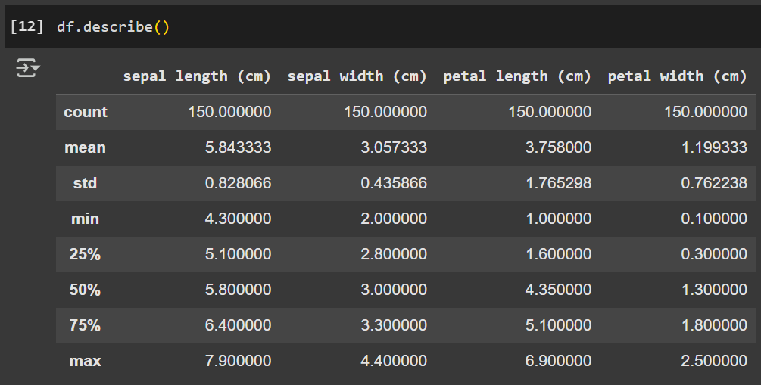
This is the descriptive statistics of the dataframe.

Slide 10
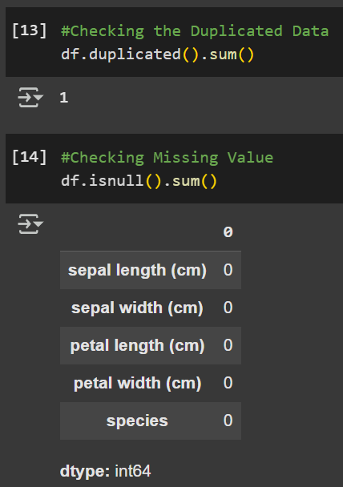
The .duplicated() method provides the duplicated data in the dataframe.
If you put .sum(), it gives us an output about the number of the duplicated data.
The .isnull() or .isna() method provides the missing value in the dataframe.
If you put .sum(), it gives us an output about the number of the missing values.

Slide 11
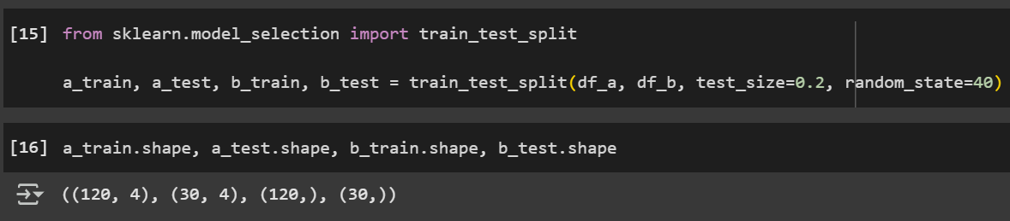
SPLIT DATA
The train test split is to split the data into a training set and a testing set. It is to train the models on the training set and then test their accuracy on the testing set.

Slide 12
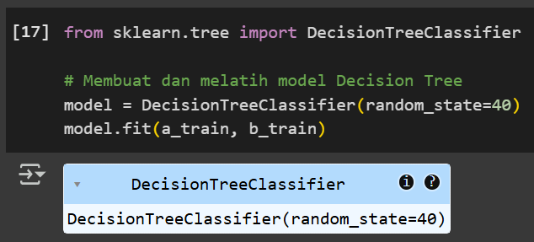
TRAIN THE MODEL

Slide 13
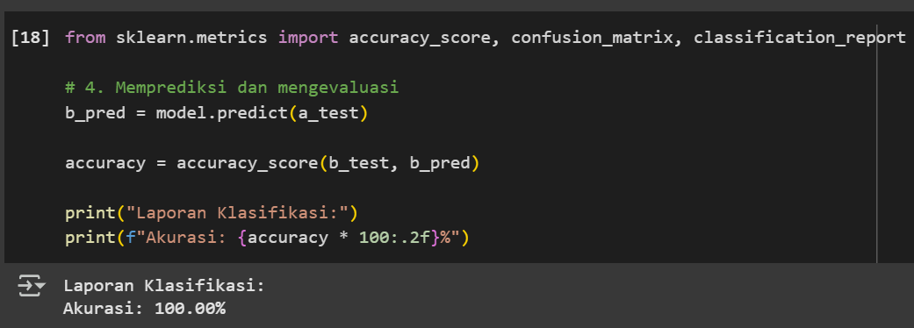
PREDICTION
From this, we can conclude that the model is 100% accurate.

Slide 14
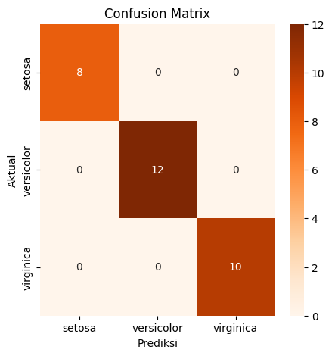
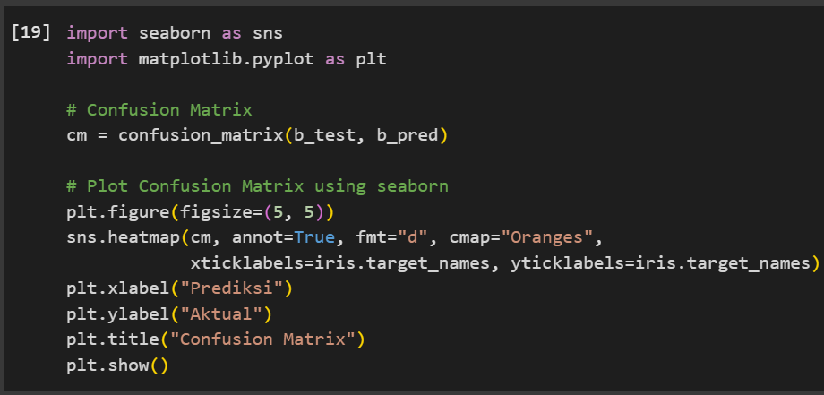
From this confusion matrix, we can conclude that there is no error. The values were accurately predicted.

Slide 15
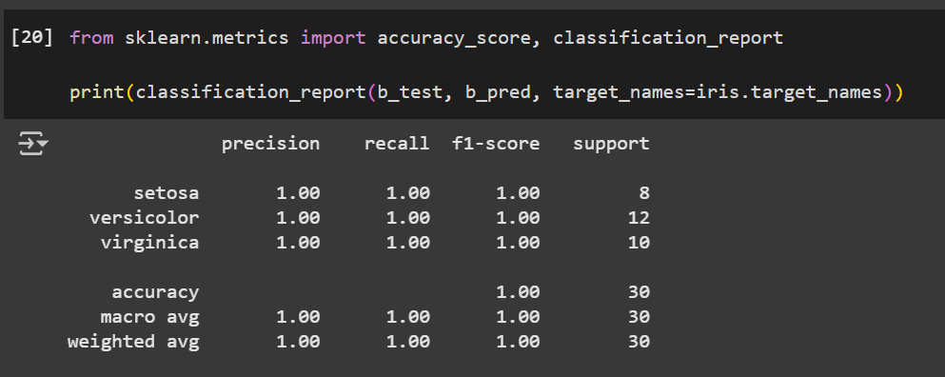
EVALUATION

Slide 16
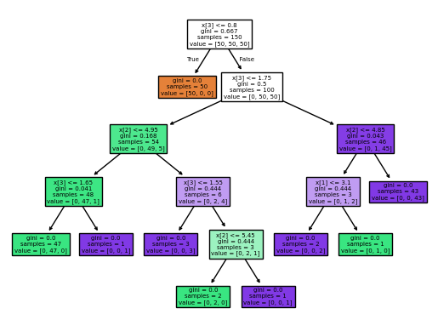
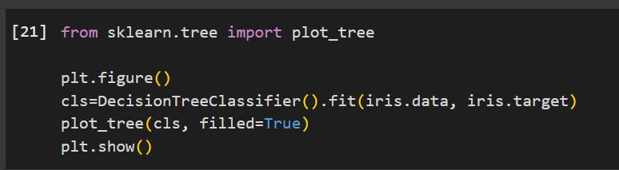
DECISION TREE
This is the tree visualization from decision tree classifier.

Slide 17
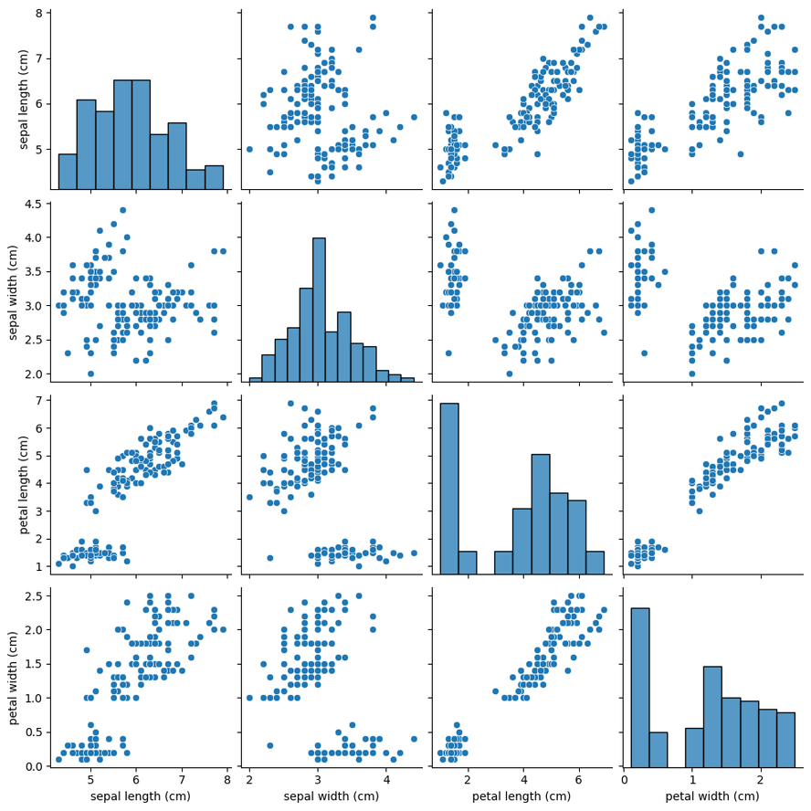
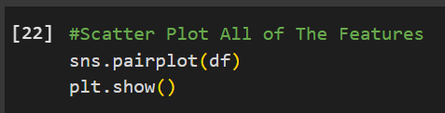
VISUALIZATION
The .pairplot() method provides scatter plot for all of the features at once.

Slide 18
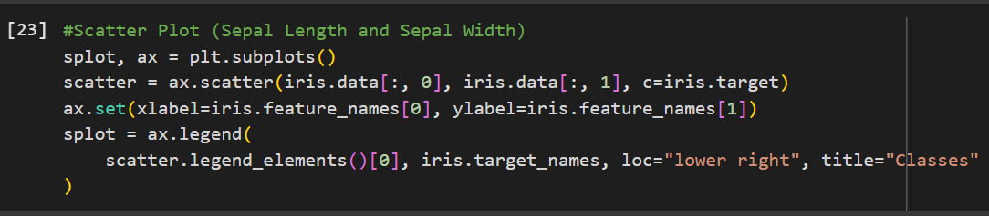
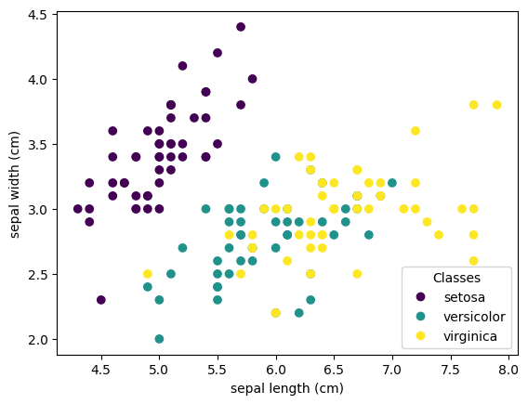
This is an example of scatter plot for sepal length and sepal width.
If you make scatter plot (without pair plot method), you will make this kind of scatter plot one by one, for sepal length and sepal width, petal length and petal width, sepal length and petal length, etc.

Slide 19

THANK YOU
GitHub Repository
https://github.com/happ-learn/Machine-Learning-Classification-Program
Contact Details
Email : hapsarikania02@gmail.com
LinkedIn : linkedin.com/in/kaniatrihapsari17

